Slide 1

Music Recommendation Application Argus Team Group Members: Oscar Alan Lozada Villa Ryan Shaw Dheeraj Savanthy Mahesh Kumar Kamalakannan Bharathwaj Thirumalai Ananthanpillai

Slide 2
Project OVERVIEW
The average person listens to music for approximately 5 hours per day on various devices.
Most listeners have playlists containing music that they enjoy and listen to daily.
An automated music recommendation application would provide listeners to music recommendations depending on their current mood.
By providing recommendations it will allow music listeners to personalize the music they listen to and provide them with songs similar to others they already enjoy.

Slide 3
PRELIMINARY SCOPE
Problem Identification
In order to properly recommend music based on the individual's current mood, the system must be able to properly sort and recommend songs that relate to that mood.
Data Source
The song will be collected from open-source music databases as well as Spotify API that provides users with songs to download for datasets.

Slide 4
PRELIMINARY SCOPE
Software & Technology
An open-source dataset as well as Spotify API for creation of song database.
Language used for programming and data handling will be “Python”
The application will be coded on Microsoft Azure and be available over the cloud.
We will utilize Azure for database storage and data collect.

Slide 5
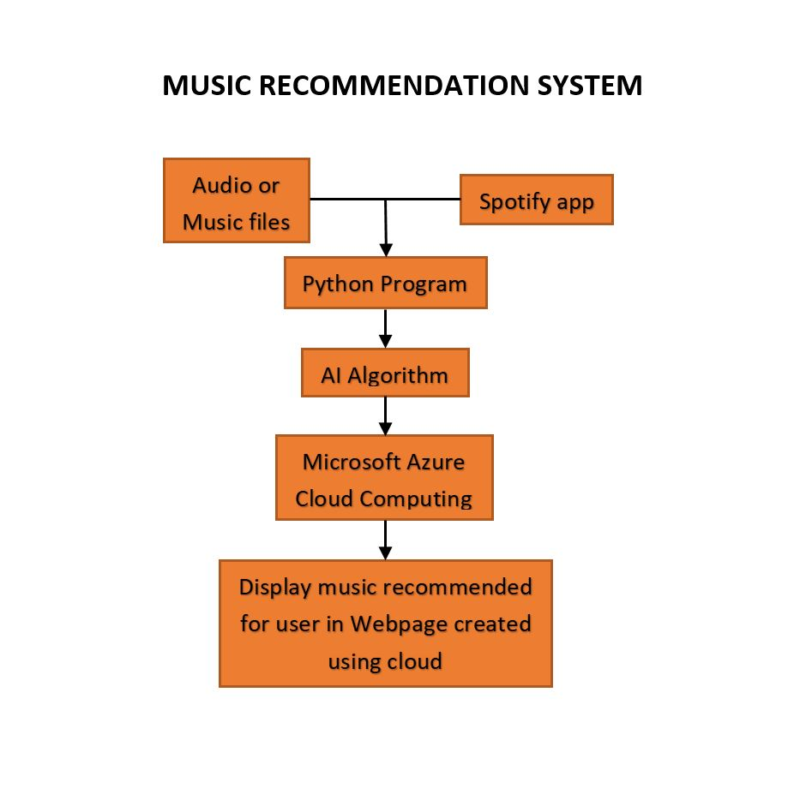
USE CASE

Slide 6
PROGRESS
Defined the preliminary scope for the music recommendation system.
Research on ideal tools, frameworks and algorithms that will help our team to reach the goal.
Team assembly and project discussion.
Azure tutorials research.
Definition of initial scope and tasks for the music recommendation development.

